Slide 1


Slide 2

TEAM SALK

Slide 3


TEAM COHEN
TEAM SALK
Predict AUC: 0.8563
 | Team Cohen | Team Salk
Predictive Performance | Predict AUC: 0.8563 Train AUC: 0.6171 Challenges: Underfitting due to low Train AUC and sensitivity/specificity Biological interpretation: Reliance on shedding (post-vaccination variable) is not useful for pre-vaccination prediction. | Predict AUC: 0.825 Train AUC: 0.9583 Predict prAUC: 0.9676 Train prAUC: 0.3911 Challenges: Overfitting with high Train AUC but lower Predict AUC. Low Train prAUC raises concerns about the minority class (12 HR vs 82 LR)
Biological Insights | HAI and IgA are relevant predictors. Shedding inclusion makes prediction harder to use as biomarker before vaccination, as this needs to be evaluated following vaccination. | Identified MAPK pathway, critical in pathogen recognition and immune responses.
Innovation | Followed a standard pipeline using provided responder variables. | Created a novel H1N1-specific responder class, showcasing creativity and exploration beyond the given task.
Predict AUC: 0.825
Training AUC: 0.6171
Training AUC: 0.9583

Slide 4

TEAM BRENNER
TEAM SALK

Slide 5
TEAM BRENNER
Predict AUC: 0.8758
 | Team Cohen | Team Salk | Team Brenner
Predictive Performance | Predict AUC: 0.8563 Train AUC: 0.6171 | Predict AUC: 0.825 Train AUC: 0.9583 Predict prAUC: 0.9676 Train prAUC: 0.3911 | Predict AUC: 0.8758 Train AUC: 0.8678
Biological Insights | HAI and IgA are relevant predictors. Shedding inclusion makes prediction harder to use as biomarker before vaccination. | Identified MAPK pathway, critical in pathogen recognition and immune responses. | Baseline blood and nasal gene signatures identified
Innovation | Followed a standard pipeline using provided responder variables. | Created a novel H1N1-specific responder class, showcasing creativity and exploration beyond the given task. | Highly innovative strategy by unbiasedly generating new responder classes using all measured parameters, identifying three distinct clusters with a strong silhouette score of 0.45.
Training AUC: 0.8678

Slide 6
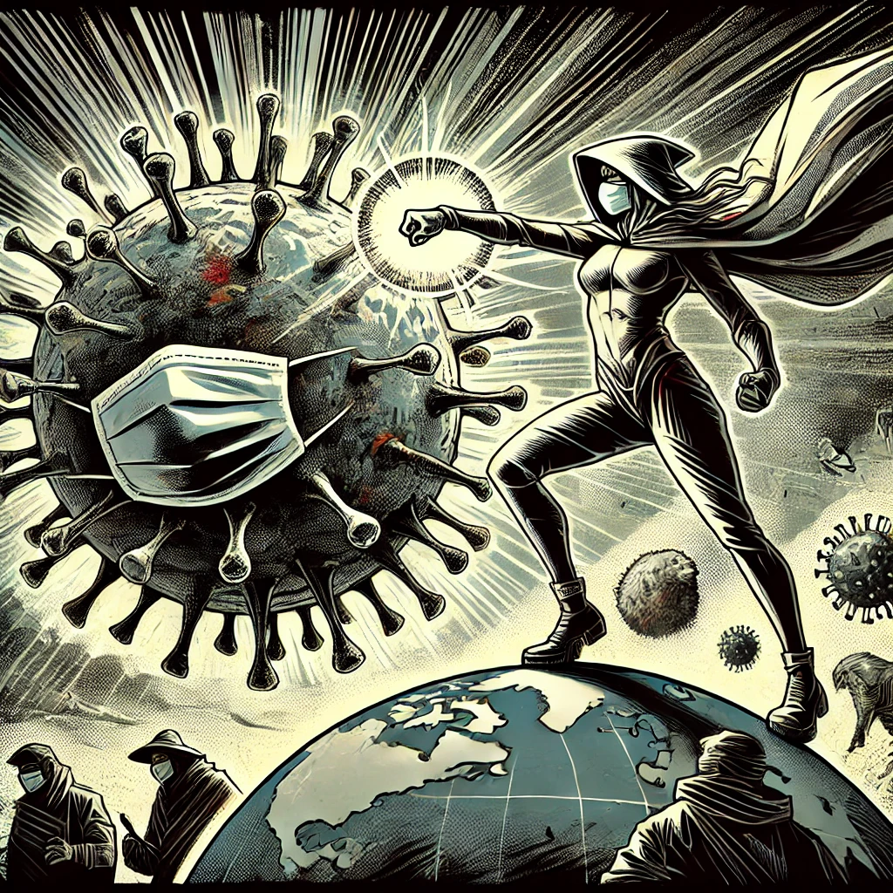
TEAM MATZINGER
TEAM BRENNER
TEAM SALK

Slide 7
THE ULTIMATE FLU FIGHTERS OF THE 2024
TEAM MATZINGER
 | Team Cohen | Team Salk | Team Brenner | Team Matzinger
Predictive Performance | Predict AUC: 0.8563 Train AUC: 0.6171 | Predict AUC: 0.825 Train AUC: 0.9583 | Predict AUC: 0.8758 Train AUC: 0.8678 | Predict AUC: 0.8956 Train AUC: 0.8176
Biological Insights | HAI and IgA are relevant predictors. Shedding inclusion makes prediction harder to use as biomarker before vaccination. | Identified MAPK pathway, critical in pathogen recognition and immune responses. | Baseline blood and nasal gene signatures identified | All baseline measurements, including gene pathways, antibody and cellular measurements, z-score, gender, pneumo load, etc.
Innovation | Followed a standard pipeline using provided responder variables. | Created a novel H1N1-specific responder class, showcasing creativity and exploration beyond the given task. | Highly innovative strategy by unbiasedly generating new responder classes using all measured parameters, identifying three distinct clusters with a strong silhouette score of 0.45. | Exceptional innovation: 4 different t-SNE/clustering methods, generating 4 datasets, and applying the entire SIMON approach - testing 143 models on each of the 4 datasets, resulting in a total of 572 analyses—leading to a comprehensive and successful strategy.
Predict AUC: 0.8956
Training AUC: 0.8176

Slide 8
TEAM MATZINGER
TEAM BRENNER
TEAM SALK

